Slide 1
E-book Emporium Using Spring Boot and JDBC in Perfect Harmony
Using HTML/CSS/JS, Springboot and MySQL
SOORYA PRAKASH M
95072352050
IInd MCA
Under the Guidance of Dr. M. Vijaya Maheswari AP/MCA

Slide 2
Introduction
The Emporium Means a place various goods are bought and sold marketplace. A large retail store or place of business furniture emporium. The E-book Emporium Using Spring Boot and JDBC in Perfect Harmony is a comprehensive digital marketplace designed for seamless e-book browsing and purchasing. It features sign-up and login pages, and a robust search functionality. Users can add books to a cart and make purchases via Google Pay, credit/debit cards, or cash on delivery. The platform includes an admin page for managing users and sales, a page for adding and managing books, and a customer page for viewing and buying books. Built with Spring Boot, MySQL, HTML/CSS/JS, and Bootstrap, the application ensures a user-friendly and efficient experience

Slide 3
Abstract
The E-book Emporium is a comprehensive digital marketplace designed to streamline the process of buying and selling e-books. Utilizing Spring Boot, MySQL, HTML/CSS/JS, and Bootstrap, the platform offers a seamless user experience. Users can easily sign up and log in to access a wide range of e-books . Advanced search capabilities allow users to find books based on their preferences quickly. The cart feature supports multiple payment options, including Google Pay, credit/debit cards, and cash on delivery, providing flexibility and convenience. For administrators, the platform offers an intuitive interface to monitor the number of users, books sold, and books added, facilitating effective management . Sellers can effortlessly add new books and manage their inventory through a dedicated admin page. Customers benefit from a streamlined product view and purchase process, enhancing their overall experience.

Slide 4
Objective
To Develop an intuitive and efficient interface for browsing, searching, and purchasing e-books using technologies like HTML/CSS/JS and Bootstrap.

Slide 5
Existing system and proposed system
Existing System:
The current e-book marketplace platforms often suffer from fragmented and cumbersome user experiences. Users face difficulties in finding and purchasing books due to inefficient search functionalities and poorly designed interfaces. Existing systems generally lack robust security features for user data and payment transactions, leading to potential breaches and mistrust among users. Furthermore, administrative and seller functionalities are often limited and not user-friendly, making inventory management and sales tracking a tedious process. The absence of seamless integration across different user roles—such as administrators, sellers, and customers—further complicates the usability and efficiency of these platforms

Slide 6
Proposed System
Proposed System:
The proposed "E-book Emporium Using Spring Boot and JDBC in Perfect Harmony" aims to revolutionize the digital book market by offering a cohesive and efficient platform for users, admin. Users can easily search for books based on their preferences and add them to their cart. The purchasing process is simplified with multiple payment options, including Google Pay, credit/debit cards, and cash on delivery, ensuring secure and flexible transactions. The admin page provides administrators with tools to view the number of users, track books sold, and manage inventory , and dedicated page to add new books and view detailed information . Customers enjoy a personalized experience with intuitive navigation and easy access to book purchases.

Slide 7
Hardware and software requirements
Hardware Requirements:
Processor: Dual-Core Processor
RAM: 4 GB or higher
Storage: SSD with 500 GB or higher
Network: High-speed internet connection
Software Requirements:
Web Server: Apache Tomcat
Database: MySQL 8.0 or higher
Java Development Kit (JDK): JDK 21 or higher
Framework: Spring Boot 4 or higher

Slide 8
Modules
Admin Module:
View Admin Page
Add New Book
Update / Delete Books
Customer Module:
View Books
Search Books
Cart Page
Payment
Database Module:
User Data
Books

Slide 9
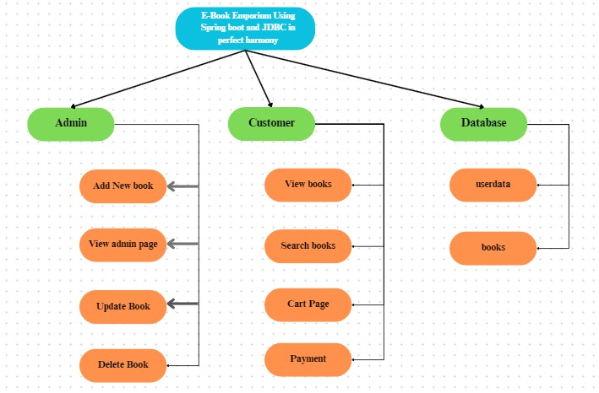
Architecture Diagram

Slide 10
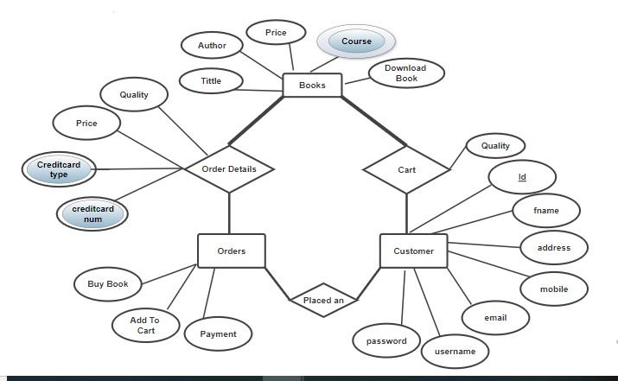
ER Diagram

Slide 11
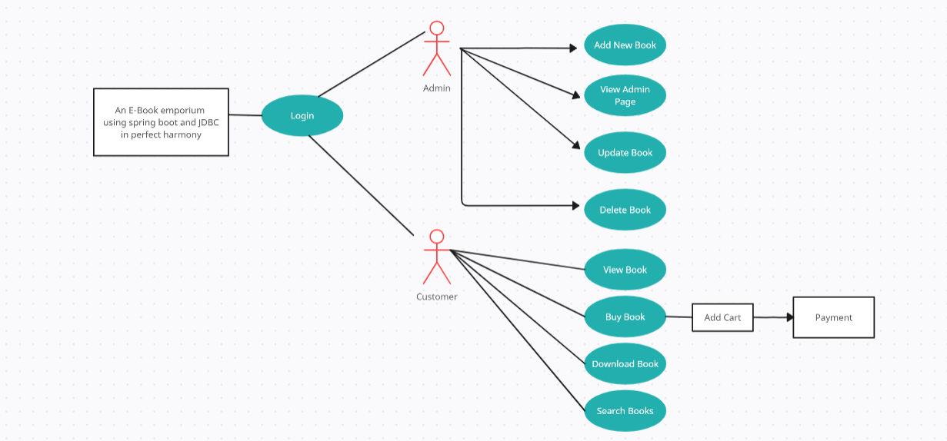
Use Case Diagram

Slide 12
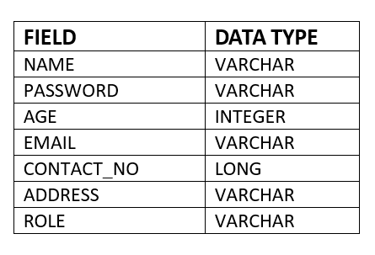
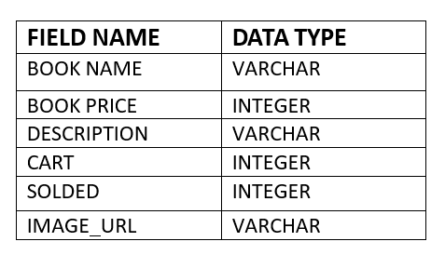
Table Design
User Data Books

Slide 13
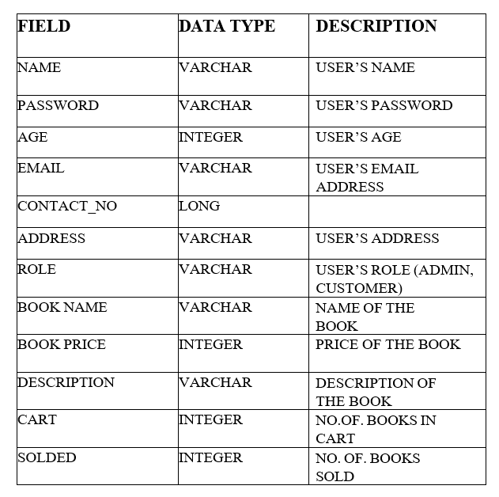
Data Dictionary

Slide 14
Output Screen

Slide 15
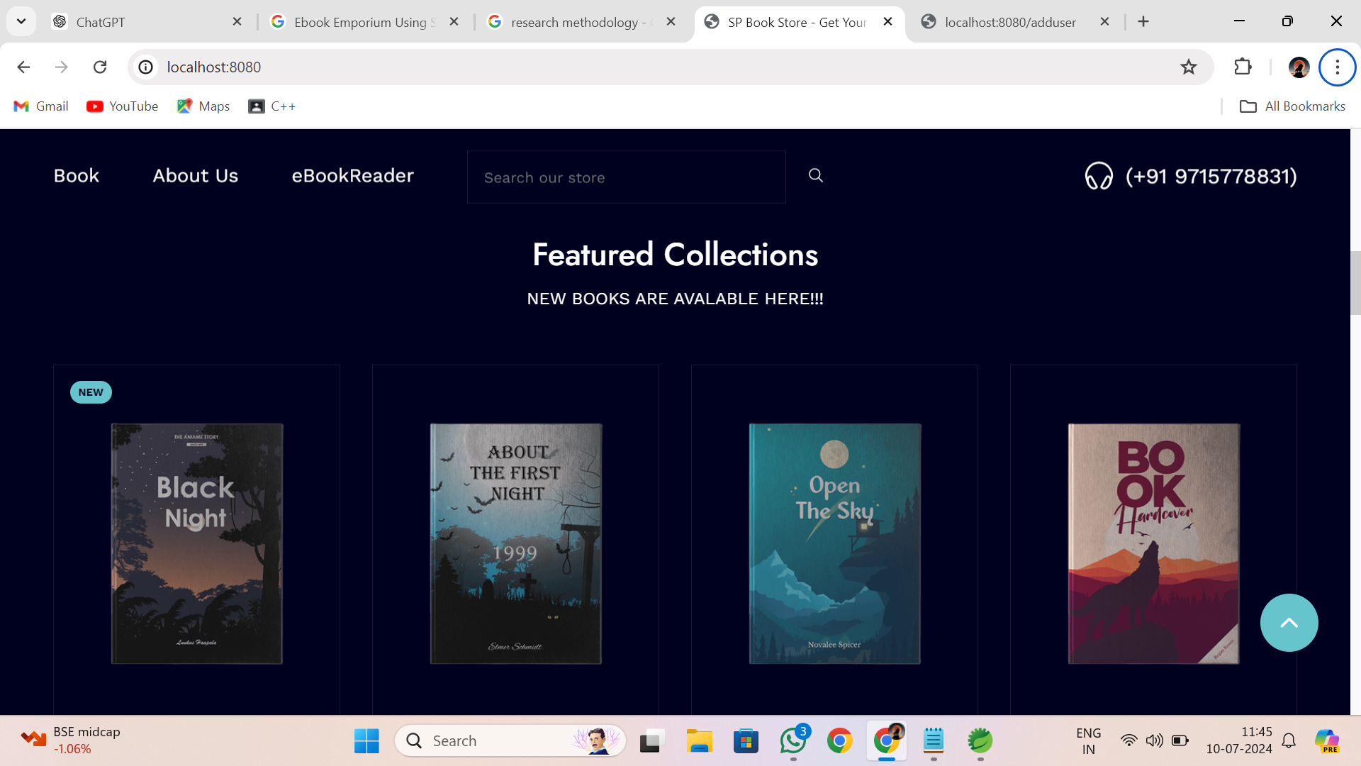
Home Page

Slide 16
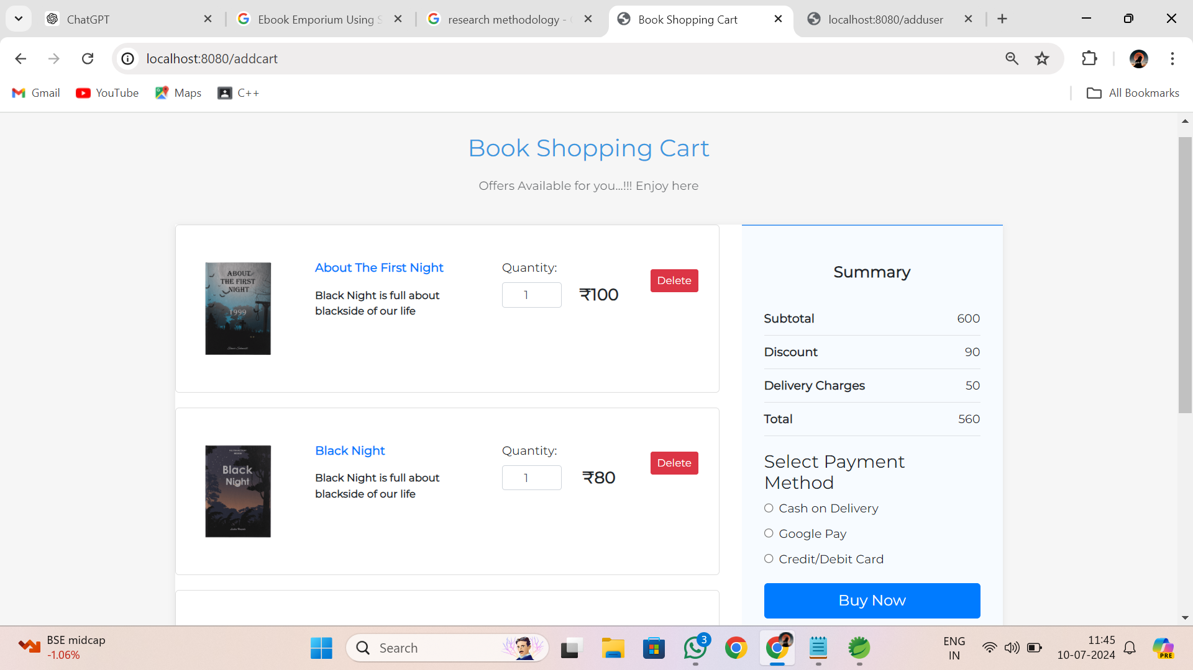
Cart Page

Slide 17
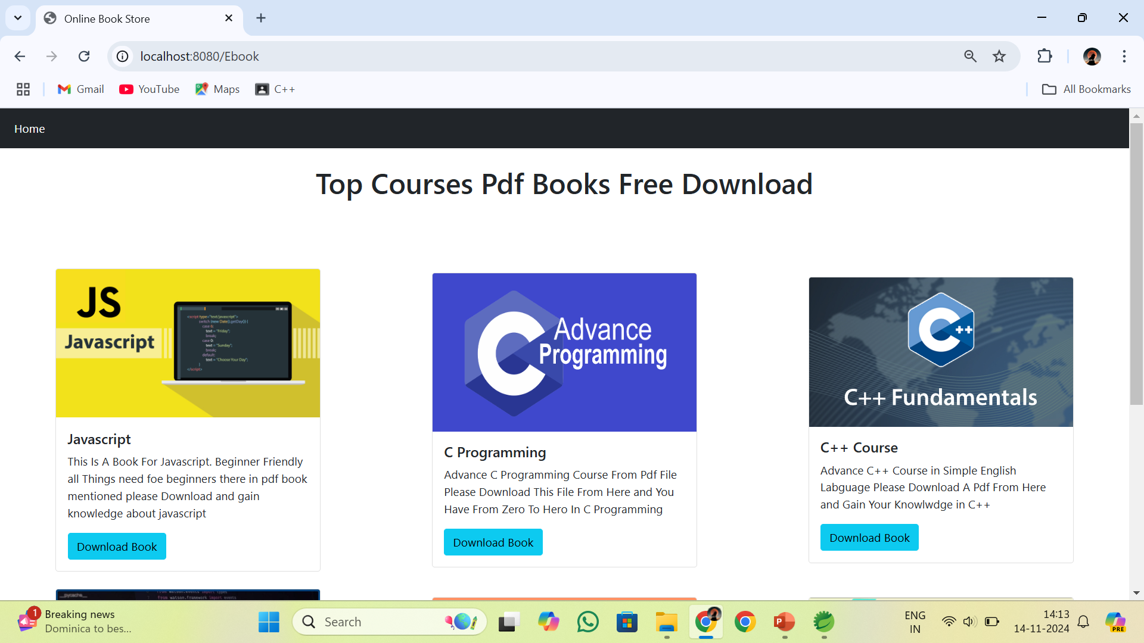
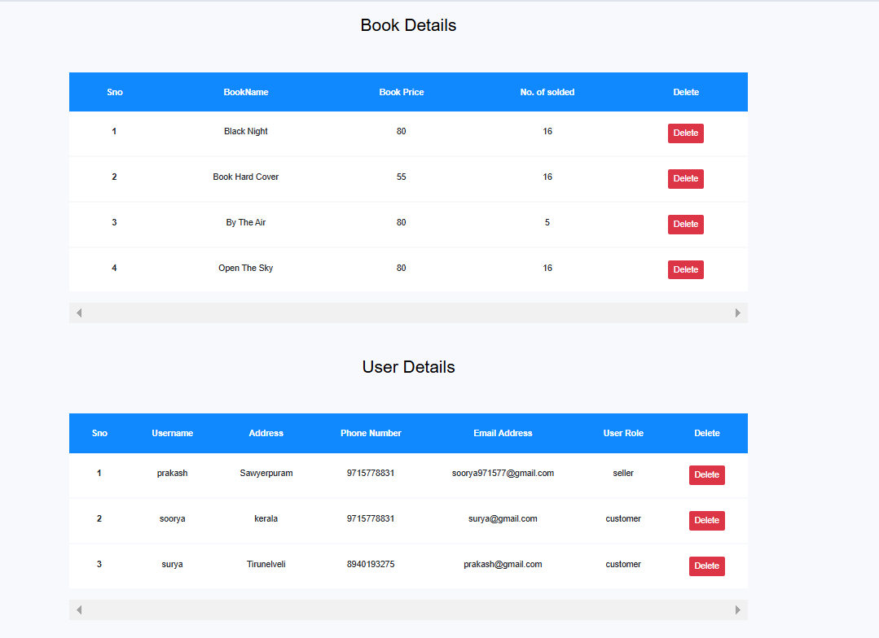
E-book Page Admin Page

Slide 18
Testing Methodology
1. Module-specific Test Cases:
Define clear test cases for each module, including the sign-up, login, product view, search, cart, payment, and user-specific pages (admin, customer).
2. Unit Testing:
Perform unit testing for backend components to ensure individual parts function correctly.
3. Integration Testing:
Conduct integration testing for database interactions to validate data consistency and system integration.
4. User Acceptance Testing:
Carry out user acceptance testing to ensure a seamless user experience across various devices and browsers.

Slide 19
Conclusion
The implementation of Spring Boot as the core framework has facilitated the development of a robust and scalable backend system. Its powerful features, such as auto-configuration, embedded servers, and comprehensive libraries, have enabled the creation of a seamless and high-performing application. Coupled with JDBC, the system ensures efficient and reliable interactions with the MySQL database, providing real-time data processing and management capabilities. The user experience has been prioritized through the development of intuitive and accessible interfaces

Slide 20
Future Enhancement
Implement a machine learning-based recommendation engine that suggests books based on user behavior, reading history, and preference.
Add a feature that allows customers to leave reviews and rate.
Develop a mobile application for ios and Android platforms to complement the web-based version of the E-book Emporium books
Introduce subscription plans for users to access a library of e-books for a monthly or yearly fee.
Create features for book clubs, forums, or reading groups where users can discuss books and share reading experiences

Slide 21
Thank You

